Slide 1


Why Programming?
Everyone uses computers, mobile phones and many other gadgets in day-to-day life to access various applications.
Different business domains like Education, Banking, E-Commerce, Healthcare, Insurance etc. use computer applications.
These applications are built using programming.
The knowledge of programming is essential to bring innovation

Slide 2

What is Programming?
A customer wants to ORDER FOOD using app.
The customer can
Open menu
select the food items and
place an order.
If the order is placed successfully, the food gets delivered to the customer.
we give instructions to the computing devices
A set of such instructions is known as a PROGRAM and the act of creating a programs is known as PROGRAMMING.
Programs - solve the problems, automate the processes and reduce repetitive and/or manual work.
To write these programs, you need a PROGRAMMING LANGUAGE

Slide 3
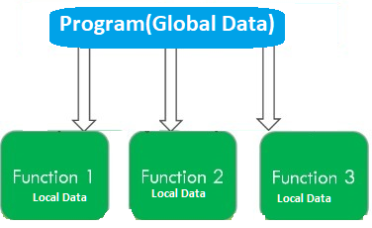
POP - Procedural Oriented Programming
What is POP?
In POP, a program is dividend into a set of procedures/functions to accomplish a task.
A procedure is a collection of instructions executed in sequential order.
Ex. read(),add(),display()..etc
Top-Down Approach: Programs are designed using a top-down approach, where you start with the main procedure and then break down the problem into smaller sub-procedures.
Data Flow: Data flows between functions as arguments and return values. It's passed explicitly between functions
Scope Limitation: Data visibility and scope are less controlled, as data can be accessed from various parts of the program

Slide 4
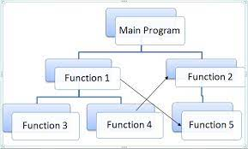
POP - Procedural Oriented Programming
Problems with POP:
Emphasis on more procedures rather than data.
Data move publicly; therefore data security cannot be maintained.
Data hiding is not possible as there are no access specifiers.
Limited code reuse:The Procedural code is often not reusable, recreation is need in another application.
Difficult to relate with real-world objects
Scalability: As programs become more complex, it's difficult to manage the increasing number of functions and dependencies.
Code Maintenance: As programs grow larger, it becomes harder to maintain due to the lack of modular structure. Changes in one part of the program can affect other parts.

Slide 5
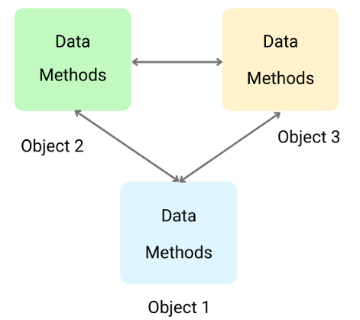
OOP -Object Oriented Programming
Modularity and Reusability: The OOP is an efficient method for design and development of software systems using REUSABLE COMPONENTS called as OBJECTS.
In OOP, the program is divided into set of objects.
In OOP emphasis more on Data.
In general, an object is a real-world entity which contains data and behavior.
An object in programming can be defined by using a Class.
i.e.. An object is an instance of a class.
A class is Template to create an object.
Supports Encapsulation, Inheritance , Polymorphism

Slide 6
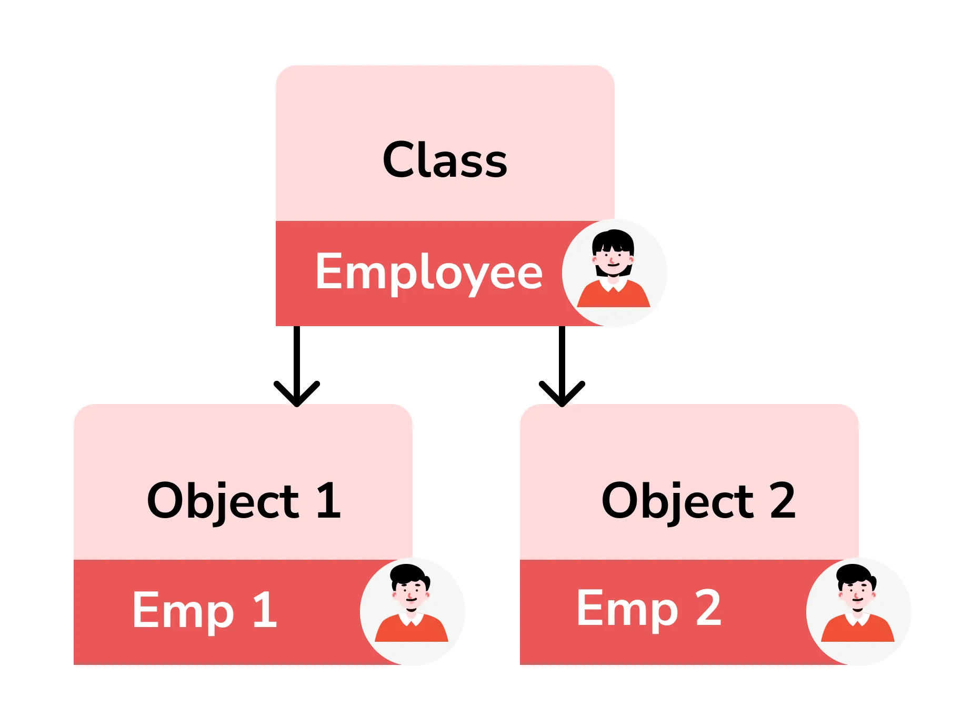
class and object
Class:
Template for declaring and creating objects
Does not contain any value
Bind data as well as methods together as a single unit
Logical Entity
Object:
Object is an instance of a class.
Memory space is assigned to them.
Each object has its own value
Objects are like a variable of the class
Physical Entity

Slide 7
class and object
//creating class
class Employee
{
//data members
int eid;
string name;
double sal;
//methods
void display() {
-----
}
};
int main() {
// Create an object of the Employee class
Employee emp;
// Assign values to the object's member variables
emp.name = "John Doe";
emp.employeeId = 101;
emp.salary = 50000.0;
// Call the display function to show employee details
emp.display();
return 0;
}

Slide 8
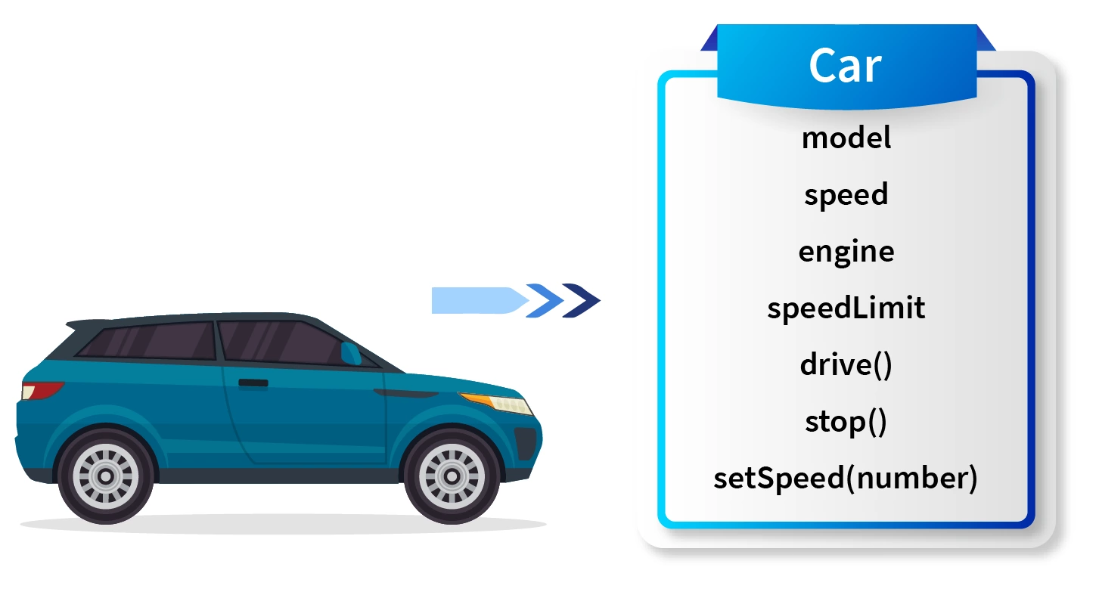
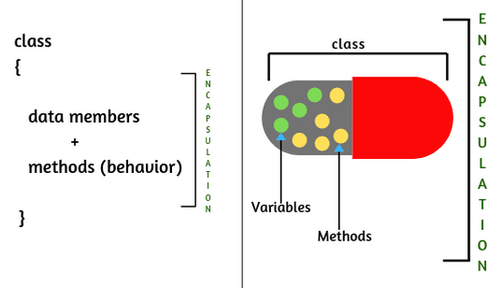
OOPs Paradigm
Encapsulation: concept of bundling data (attributes) and the methods (functions) into a single unit called a class
Wrapping of data and functions together as a single unit is known as encapsulation.
Example: Car
In a car we have so many functionalities like drive(), stop(), setSpeed(number) etc. which helps us to control the car while driving,
Properties of a car like model, speed, engine, speedLimit etc. which gives us the various information about the car.

Slide 9
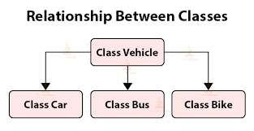
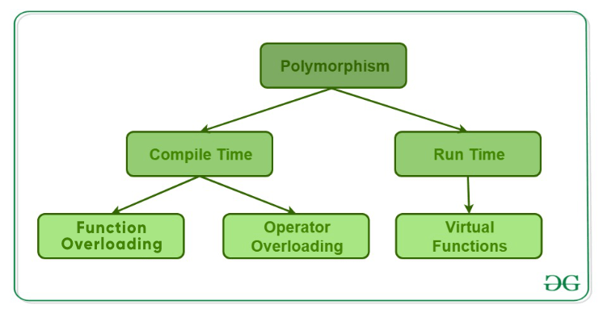
OOPs Paradigm
Inheritance:
Acquiring the properties and behaviors (attributes and methods) from another class, establishing a hierarchical relationship between classes. The class that is inherited from is called the base class or parent class,
Encapsulation: concept of bundling data (attributes) and the methods (functions) into a single unit called a class
Polymorphism in simple means having many forms. Its behavior is different in different situations

Slide 10
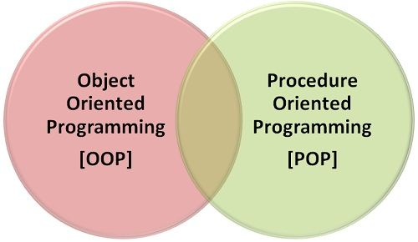
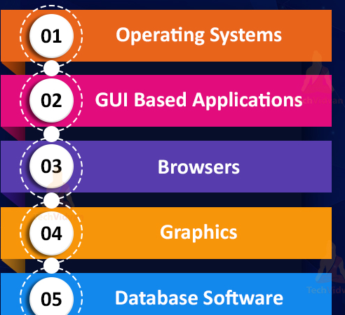
C++ Overview
C++ is a combination of OOP and POP paradigms.
Developed from the original C . It adds features like classes and objects,
C++ is utilized in a wide range of applications, from system software development to game development, high-performance applications, scientific simulations, and more.
Platform Compatibility: C++ is highly portable and can be used on various platforms, including Windows, Linux, macOS, and embedded systems. It's a popular choice for systems programming due to its low-level capabilities.
Application Domains: C++ is employed to develop applications such as desktop software, games, performance-critical software, real-time systems, embedded systems, and more

Slide 11

History of C++ Programming
Bjarne Stroustrup developed C++ in the early 1980s.
It evolved from the C programming language and was aimed at adding object-oriented features to C.
C++ was first referred to as "C with Classes.“
The language's name, C++, reflects the notion of "incremental improvement" over C.
C++ introduced the concept of classes, which allows for object-oriented programming (OOP) principles like encapsulation, inheritance, and polymorphism.
Templates were introduced, enabling generic programming and the creation of reusable code for various data types.
C++11, C++14, C++17, and C++20 are subsequent standards that introduced various features and improvements.

Slide 12
C | C++
It is a function-driven language. | It is an object-driven language.
C is a Procedural Oriented language. It does not support object-oriented programming (OOP) features such as polymorphism, encapsulation, and inheritance programming. | C++ is both a procedural and an object-oriented programming language. It supports OOP features such as polymorphism, encapsulation, and inheritance.
Supports built-in data types. | Supports both built-in and user-defined data types.
C focuses on method or process rather than data. | C++ focuses on data rather than method or procedure.
Does not support function and operator overloading. | Supports function and operator overloading.
Does not support any reference variables. | Supports reference variables
The main () function can be called through other functions used in the code. | Does not allow the main () function to be called through other functions.

Slide 13
Structures versus Classes
structure is the same as the class with some differences.
Security is the most important thing for both structure and class.
A structure is not safe because it could not hide its implementation details from the end-user, whereas a class is secure as it may hide its programming and design details.
A structure is a grouping of variables of various data types referenced by the same name.
--------------------------------------------------------------------------------
struct structurename
{
Struct_member1;
Struct_member2;
Struct_member3;
.
.
.
struct_memberN;
}
→ Public access of data members
A class in C++ is similar to a C structure in that it consists of a list of data members and a set of operations performed on the class.
------------------------------------------------------------------------------------
class class_name
{
// private data members and member functions.
access specifier Data member;
member functions (member list){ . . }
};
OOP's main function is data hiding, which is achieved access specifiers:
→Data will have "public", "private“ access

Slide 14
Structures versus Classes
// creating strucure
#include <iostream>
using namespace std;
struct BankAccount {
string accountNumber;
double balance;
};
int main() {
BankAccount acc1;
acc1.accountNumber = "12345";
acc1.balance = 1000.0;
displayAccount(acc1);
return 0;
}
//creating class
#include <iostream>
using namespace std;
class BankAccount {
public:
int acc_num;
private:
double bal;
void display() {
cout << "Account Number: " << acc_num << endl;
cout << "Balance: $" << bal << endl;
}
};
int main() {
BankAccount acc1;
acc1.acc_num = "12345";
acc1.bal = 1000.0;
acc1.display();
return 0;
}

Slide 15
Structures versus Classes
Features | Structure | Class
Definition | A structure is a grouping of variables of various data types referenced by the same name. | In C++, a class is defined as a collection of related variables and functions contained within a single structure.
Basic | If no access specifier is specified, all members are set to 'public'. | If no access specifier is defined, all members are set to 'private'.
Instance | Structure instance is called the 'structure variable'. | A class instance is called 'object'.
Inheritance | It does not support inheritance. | It supports inheritance.
Memory Allocated | Memory is allocated on the stack. | Memory is allocated on the heap.
Nature | Value Type | Reference Type
Purpose | Grouping of data | Data abstraction and further inheritance.
Usage | It is used for smaller amounts of data. | It is used for a huge amount of data.
Null values | Not possible | It may have null values.
Requires constructor and destructor | It may have only parameterized constructor. | It may have all the types of constructors and destructors.

Slide 16
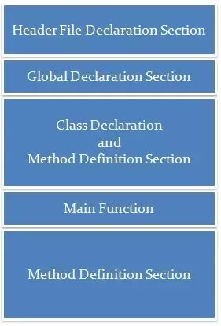
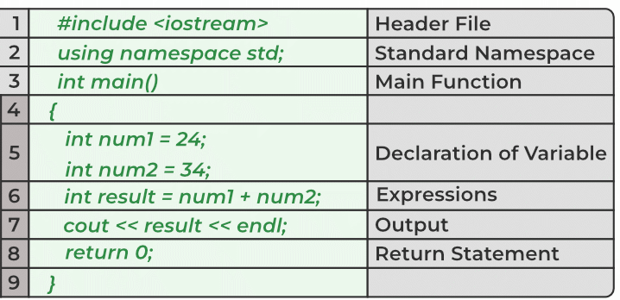
Structure of C++ program
C++ program with out class
C++ program with class

Slide 17
Console input and output (I/O)
//program to disp your name
#include <iostream>
using namespace std;
int main() {
cout << “Naveen”<< endl;
return 0;
}
To display output on the console, you can use cout
cout available in iostram
#include <iostream>
using namespace std;
int main() {
int age;
cout << "Enter your age: ";
cin >> age;
cout << “ You entered: " << age << " years.“;
return 0;
}
To read input from the user, you can use the cin
In C++, std is the standard namespace that is used to organize the names of standard library elements like classes, functions, and variables.
.

Slide 18
Question) Write a C++ program that takes the name, employee ID, and salary of an employee as input and displays their details.
Input:
Enter employee name: John Doe
Enter employee ID: 101
Enter salary: 50000
Output:
Employee Details:
Name: John Doe
Employee ID: 101
Salary: $50000
LOGIC
Declare variables name (string), employeeID (integer), and salary (double).
Prompt the user to input the employee's name, employee ID, and salary.
Read the input using getline for the name and cin for the other inputs.
Display the employee details using the entered values.

Slide 19
//Employee details
#include <iostream>
using namespace std;
int main() {
string name;
int employeeID;
double salary;
//read emp details
cout << "Enter employee name: ";
getline(cin, name);
cout << "Enter employee ID: ";
cin >> employeeID;
cout << "Enter salary: ";
cin >> salary;
//display emp details
cout << "\nEmployee Details:" << endl;
cout << "Name: " << name << endl;
cout << "Employee ID: " << employeeID << endl;
cout << "Salary: $" << salary << endl;
return 0;
}
cin
cin is used to read input from the standard input stream.
It reads input until the first whitespace character (space, tab, newline) is encountered.
It leaves any remaining characters after the whitespace in the input buffer, which can cause issues when reading further input.
cin can be used for reading individual words or numeric values.
getline()
getline() is used to read an entire line of text from the input stream.
It reads the entire line, including spaces, until a newline character is encountered.
It discards the newline character from the input, preventing issues when reading further input.
getline() is commonly used to read strings or lines of text, including those that might contain spaces.

Slide 20
Write a C++ Program to swap two numbers without third variable.
There are two common ways to swap two numbers without using third variable:
By + and -
By * and /
Input:
Enter two numbers:
Number 1: 5
Number 2: 10
Output:
Before swapping:
Number 1: 5
Number 2: 10
After swapping:
Number 1: 10
Number 2:
Logic:
Declare two variables num1 and num2 to store the input numbers.
Read the two numbers from the user.
Print the numbers before swapping.
Swap the numbers using addition and subtraction:
num1 = num1 + num2
num2 = num1 - num2
num1 = num1 - num2
Print the numbers after swapping.

Slide 21
//swap two numbers without third variable
#include <iostream>
using namespace std;
int main() {
int num1, num2;
cout << "Enter two numbers:" << endl;
cout << "Number 1: ";
cin >> num1;
cout << "Number 2: ";
cin >> num2;
cout << "\nBefore swapping:" << endl;
cout << "Number 1: " << num1 << endl;
cout << "Number 2: " << num2 << endl;
// Swapping using addition and subtraction
num1 = num1 + num2;
num2 = num1 - num2;
num1 = num1 - num2;
cout << "\nAfter swapping:" << endl;
cout << "Number 1: " << num1 << endl;
cout << "Number 2: " << num2 << endl;
return 0;
}

Slide 22
What will be the output of following program ?
#include <iostream>
using namespace std;
int main() {
int a = 3, b = 2;
a = a == b == 0;
cout << a << "," << b << endl;
return 0;
}
What will be the output of this program?
a) 1,2
b) 0,2
c) 1,0
d) 0,0

Slide 23
What will be the output of following program ?
#include <iostream>
using namespace std;
int main() {
int a = 3, b = 2;
a = a == b == 0;
cout << a << "," << b << endl;
return 0;
}
Correct Answer 1,2
a=a==b==0;
Since the associability is left to right for == operator, thus (a==b) is evaluated first which results in 0 as a =3 & b=2
a=3==2==0
a=0==0
a=1
Now 0==0 which assigns 1 to a
Thus finally a=1 & b=2

Slide 24
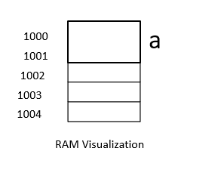
Variables in C++
A Variable is a name given to the memory location.
It is used to store data
Its value can be changed, and it can be reused many times.
a
Variable Declaration:
10
int a;
float b;
1000
4 bytes
b
Variable Initialization:
10.456000
a = 10;
b = 10.456;
2000
4 bytes

Slide 25
Variable Declaration:
char a = ‘s’ // alphabets
char a = ‘?’ // special symbols
char a = ‘3’ // numeric
char :
1 byte
S, ? and 3 - anything in single quotes is stored as an character

Slide 26
How many are valid variables name..?
NUMBER
_num
93num
num93
first.name
first_name
last nam
nUMBER
mid.name
4321

Slide 27
Variable name:
Rules:
int num;
Lower case
Upper case
Lower and Upper case
C++ Language is case sensitive
int NUM;
int Num ;
num, Num, NUM - all three are different variable names.

Slide 28


Variable name:
Rules:
Underscore can be placed anywhere
Except Underscore no other special characters are allowed
(like dot, white space, etc.,)
int _num;
int num_;
int Num_ber ;
int Num.ber ;
int Num ber ;

Slide 29
Variable name:
Rules:
int 9num;
First character should be alphabet or underscore
Digits 0 – 9 are allowed
Variable name should not be a keyword
int num9;
int Num_7_is ;
int float;

Slide 30
How many are valid variables name..?
NUMBER
_num
93num
num93
first.name
first_name
last nam
nUMBER
mid.name
4321

Slide 31
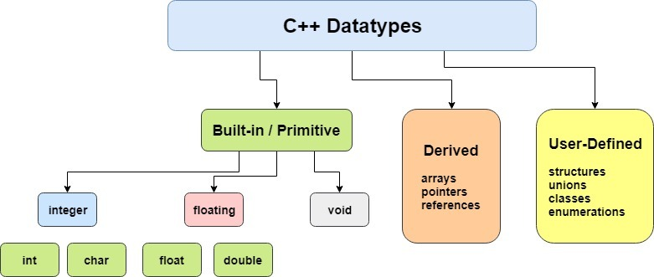
Data Types in C++
Datatype defines the type of data being used.
Whenever we define a variable, we have to specify the type of the data, so that the compiler knows what type of data to expect.

Slide 32
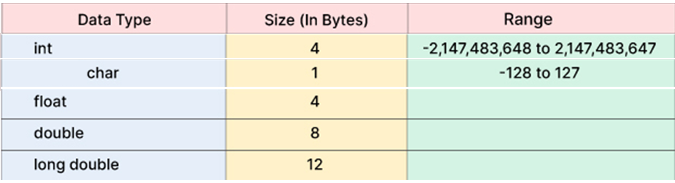
Data Types in C++
Modifiers
Size modifier
Sign modifier
Long
Signed
short
Unsigned
eg. -> int a = 5550; float a = 0.05; double a = 10.09; char b = ‘A’;
The size for different data types depends on the compiler and processor types
signed | unsigned
Negative and Positive value represent by signed | Only Positive value represented by unsigned

Slide 33
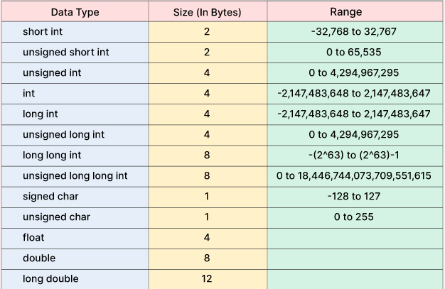
Data Types in C++

Slide 34
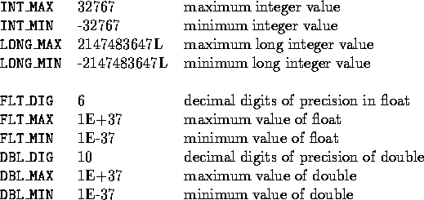
Data types
sizeof() operator in C++
The sizeof() is an operator that evaluates the size of data type, constants, variable.
It is a compile-time operator as it returns the size of any variable or a constant at the compilation time.
sizeof(data_type);
int a=10;
Sizeof(a); → 4 bytes
<climits>(limits.h) defines sizes of integral types.
This header defines constants with the limits of fundamental integral types
The limits for fundamental floating-point types are defined in <cfloat> (<float.h>).

Slide 35
Q)Write a in C++ program to find the size of fundamental data types.
#include <iostream>
using namespace std;
int main()
{
// Determining the space in bytes occupied by each data type.
cout << "Size of integer data type : " <<sizeof(int)<< std::endl;
cout << "Size of float data type : " <<sizeof(float)<< std::endl;
cout << "Size of double data type : " <<sizeof(double)<< std::endl;
cout << "Size of char data type : " <<sizeof(char)<< std::endl;
return 0;
}

Slide 36
Q) Write a in C++ program to check the upper and lower limits of integers.
#include <iostream>
#include <climits> // integer limits in header file
using namespace std;
int main()
{
cout << "\n\n Check the upper and lower limits of integer :\n";
cout << "--------------------------------------------------\n";
cout << " The maximum limit of int data type : " << INT_MAX << endl;
cout << " The minimum limit of int data type : " << INT_MIN << endl;
cout << " The maximum limit of char data type : " << CHAR_MAX << endl;
cout << " The minimum limit of char data type : " << CHAR_MIN << endl;
cout << endl;
return 0;
}

Slide 37
Other Data Types in C++
User-Defined Types:
struct: Allows you to create a composite data type by grouping variables of different data types under a single name.
class: Like a struct, but with added member functions and access control.
Derived Data Types:
arrays: Collection of elements of the same data type.
pointers: Variables that store memory addresses.
references: Aliases for other variables.
Enumerations:
enum: Defines a set of named integer constants.

Slide 38
Question: Integer Operations
Write a program that takes two integer inputs and performs the following operations:
Addition
Subtraction
Multiplication
Division (consider integer division and also handle division by zero)
Input:
Enter first integer: 10
Enter second integer: 5
Output:
Addition: 15
Subtraction: 5
Multiplication: 50
Division: 2
Logic:
Read two integers from the user.
Perform addition, subtraction, multiplication, and division operations.
Print the results.

Slide 39
// Program for Integer Operations
#include <iostream>
using namespace std;
int main() {
int num1, num2;
cout << "Enter first integer: ";
cin >> num1;
cout << "Enter second integer: ";
cin >> num2;
int addition = num1 + num2;
int subtraction = num1 - num2;
int multiplication = num1 * num2;
cout << "Addition: " << addition << endl;
cout << "Subtraction: " << subtraction << endl;
cout << "Multiplication: " << multiplication << endl;
if (num2 != 0)
{
int division = num1 / num2;
cout << "Division: " << division << endl;
}
else
{
cout << "Division by zero is not allowed." << endl;
}
return 0;
}

Slide 40
Q) What is the value of p in the following C++ code snippet?
#include <iostream>
using namespace std;
int main()
{
int p;
bool a = true;
bool b = false;
int x = 10;
int y = 5;
p = ((x | y) + (a + b));
cout << p;
return 0;
}
a) 12
b) 0
c) 2
d) 1

Slide 41
Q) What is the value of p in the following C++ code snippet?
#include <iostream>
using namespace std;
int main()
{
int p;
bool a = true;
bool b = false;
int x = 10;
int y = 5;
p = ((x | y) + (a + b));
cout << p;
return 0;
}
a) 12
b) 0
c) 2
d) 16
Answer: d Explanation:
| means bitwise OR operation so x | y (0101 | 1010) will be evaluated to 1111 which is integer 15 and as a is true and b is false so a+b(1 + 0) = 1.
So final value of expression in line #10 will be 15 + 1 = 16.

Slide 42
Predict the output of following program.
#include <iostream>
using namespace std;
int main() {
int a = 10;
int b = 2;
int c;
c = (a & b);
cout << "c = " << c << endl;
return 0;
}

Slide 43
Predict the output of following program.
#include <iostream>
using namespace std;
int main() {
int a = 10;
int b = 2;
int c;
c = (a & b);
cout << "c = " << c << endl;
return 0;
}
Correct answer:
c= 2
Bitwise AND (&), It does AND on every bits of two numbers. The result of AND is 1 only if both bits are 1.
a=10 //0000 1010
b=2 //0000 0010
Doing bitwise AND
0000 0010 ➔2

Slide 44
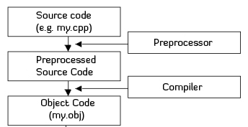
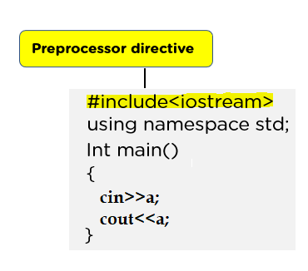
Preprocessor directives
Instructions that are processed by the preprocessor before the actual compilation of the source code.
include or exclude code, define macros, and perform other preprocessing tasks.
identified by starting with a # symbol.
Include Directive (#include):
#include <iostream> // Includes the contents of the iostream header file
You can include both system header files using angle brackets (< >) and user-defined header files using double quotes (" ").

Slide 45
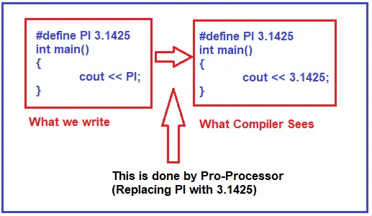
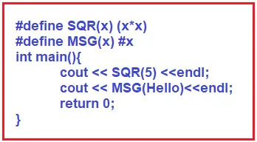
Preprocessor directives
Macro Definition (#define):
This directive is used to define a macro, which is a piece of code that can be replaced with its corresponding value or expression during preprocessing.
#define PI 3.1425
Define Function using #define Preprocessor Directive in C++:
Using #define, we can also define functions.

Slide 46
Q) Write a program that uses the preprocessor directive #define to define the value of PI
//program that uses the preprocessor directive #define to define the value of PI:
#include <iostream>
using namespace std;
// Define a macro named PI with the value 3.14159
#define PI 3.14159
int main()
{
double radius;
cout << "Enter the radius of the circle: ";
cin >> radius;
// Using the PI macro
double area = PI * radius * radius;
double circumference = 2 * PI * radius;
cout << "The area of the circle is: " << area << endl;
cout << "The circumference of the circle is: " << circumference << endl;
return 0;
}

Slide 47
Q) Write a macro named SQUARE that calculates the square of a number
// Define a macro named SQUARE that calculates the square of a number
#include <iostream>
using namespace std;
#define SQUARE(x) ((x) * (x))
int main() {
int num;
cout << "Enter a number: ";
cin >> num;
// Using the SQUARE macro to calculate the square of the input number
int square = SQUARE(num);
cout << "The square of " << num << " is: " << square << endl;
return 0;
}

Slide 48
Q) Write a macro named MAX that returns the maximum of two numbers
// Define a macro named MAX that returns the maximum of two numbers
#include <iostream>
using namespace std;
#define MAX(a, b) ((a > b) ? a : b)
int main() {
int num1, num2;
cout << "Enter the first number: ";
cin >> num1;
cout << "Enter the second number: ";
cin >> num2;
// Using the MAX macro to find the maximum of the two numbers
int maxNumber = MAX(num1, num2);
cout << "The maximum of " << num1 << " and " << num2 << " is: " << maxNumber << endl;
return 0;
}

Slide 49
Preprocessor directives
Conditional Compilation directives:
(#ifdef, #ifndef, #else, #elif, #endif):
These directives allow you to conditionally include or exclude portions of code based on predefined macros or other conditions.
Syntax:
#ifdef
// code here
#endif
Ex.
#ifdef TEST
// code here
#endif
#include <stdio.h>
#define AGE 32
int main()
{
//executes if AGE is present
#ifdef AGE
printf("I am %d years old.\n", AGE);
#endif
return 0;
}

Slide 50
Preprocessor directives
Conditional Compilation directives:
(#ifdef, #ifndef, #else, #elif, #endif):
These directives allow you to conditionally include or exclude portions of code based on predefined macros or other conditions.
#include <iostream>
using namespace std;
// Define macros for different operating systems
#define WINDOWS
int main() {
#ifdef WINDOWS
cout << "Running on Windows." << endl;
#elif defined(LINUX)
cout << "Running on Linux." <<endl;
#elif defined(MAC)
cout << "Running on macOS." << endl;
#else
cout << "Running on an unknown operating system." << endl;
#endif
return 0;
}
#ifdef MACRO_NAME
// Code to execute if MACRO_NAME is defined
#elif defined(ANOTHER_MACRO)
// Code to execute if ANOTHER_MACRO is defined
#else
// Code to execute if neither MACRO_NAME nor ANOTHER_MACRO is defined
#endif

Slide 51
Preprocessor directives
File Inclusion (#include):
Apart from including header files, you can include the contents of a text file directly into the source code using #include
Assume you have a header file named myheader.h with the following content:
create a program that includes and uses the functions from myheader.h
//myheader.h
#ifndef MYHEADER_H
#define MYHEADER_H
void printMessage() {
cout << "Hello from myheader.h" << endl;
}
#endif
#include <iostream>
#include "myheader.h" // Include the contents of myheader.h
using namespace std;
int main() {
cout << "Before calling printMessage()" << endl;
printMessage(); // Call the function from myheader.h
cout << "After calling printMessage()" << endl;
return 0;
}

